Slide 1

Malla Reddy Engineering College for Women
UGC Autonomous Institution
Accredited by NBA & NAAC with A+ Grade
Approved by AICTE , Affiliated to JNTUH , ISO 9001:2015 Certified Institution
Maisammaguda , Dhulapally , Secunderabad-500100
Title of the Idea : REVOLUTIONIZING AGRICULTURE : PREDICTING CROPS WITH AI AND
WEATHER DATA
Name of the Student : T.Varshitha, T.Sruthi, T.Srivalli
Branch & Year : AIML 2ND YEAR
Roll Number : 23RH1A66W9, 23RH1A66V9, 23RH1A66X0
Guide : Mrs. Spandana

Slide 2
REVOLUTIONIZING AGRICULTURE : PREDICTING CROPS WITH AI AND WEATHER DATA
INTRODUCTION
Selecting the right crops depends on various factors, including geographical location, temperature, and precipitation.
Different regions have unique weather patterns, making it essential to understand climate zones for better crop selection.
Crop recommendation systems enhance agricultural productivity by analyzing soil and climate conditions to suggest the best-suited crops.

Slide 3
REVOLUTIONIZING AGRICULTURE : PREDICTING CROPS WITH AI AND WEATHER DATA
PROBLEM STATEMENT
Farmers and gardeners face the challenge of selecting the most suitable crops for their specific conditions to achieve optimal yield and sustainability. With varying climate conditions, soil types, and resource availability, choosing the right crops involves balancing multiple factors to ensure successful growth and productivity.
Given a set of environmental and resource parameters, there is a need for a systematic approach to recommend the most appropriate crops. This recommendation should optimize crop yield and quality while considering factors such as climate, soil type, seasonality, and resource constraints.

Slide 4
REVOLUTIONIZING AGRICULTURE : PREDICTING CROPS WITH AI AND WEATHER DATA
OBJECTIVES
To recommend the most suitable crop based on soil nutrients, pH levels, and rainfall data.
To enhance agricultural productivity.
Use resources like water and nutrients efficiently.
Promote sustainable farming.
To reduce crop failure risks by recommending crops that match the environmental conditions.
To simplify decision-making for farmers using a user-friendly system.

Slide 5
REVOLUTIONIZING AGRICULTURE : PREDICTING CROPS WITH AI AND WEATHER DATA
EXISTING SYSTEM
Traditional crop selection methods rely on farmers' experience, local knowledge, and general weather patterns, often leading to suboptimal decisions. Some existing systems use basic soil testing and manual recommendations but lack accuracy and scalability.
Advanced approaches involve agricultural databases and static guidelines without real-time adaptability.
The need for a more precise, automated, and data-driven approach highlights the importance of an advanced crop recommendation system.

Slide 6
REVOLUTIONIZING AGRICULTURE : PREDICTING CROPS WITH AI AND WEATHER DATA
DISADVANTAGES OF EXISTING SYSTEM
Lack of Accuracy – Relies on traditional knowledge, leading to suboptimal crop selection.
No Real-Time Data – Does not integrate live soil or weather updates.
Limited Use of Technology – Lacks AI and machine learning for precise predictions.
Higher Risk of Crop Failure – Poor decision-making increases the chances of low yield.
Manual Effort Required – Farmers need to analyze multiple factors manually.

Slide 7
REVOLUTIONIZING AGRICULTURE : PREDICTING CROPS WITH AI AND WEATHER DATA
PROPOSED SYSTEM
The crop recommendation system is designed to assist farmers in selecting the most suitable crop based on soil and climatic conditions.
By utilizing essential parameters such as soil nutrients, pH level, and rainfall data, the system provides accurate recommendations to enhance agricultural productivity.
This system aims to optimize crop selection, improve yield, and promote sustainable farming practices.
It ensures that farmers make informed decisions based on scientific analysis, leading to better resource utilization and increased efficiency in cultivation.

Slide 8
REVOLUTIONIZING AGRICULTURE : PREDICTING CROPS WITH AI AND WEATHER DATA
ADVANTAGES OF PROPOSED SYSTEM
Optimized Crop Selection – Suggests the most suitable crop based on soil and climatic conditions, improving yield.
Enhanced Agricultural Productivity – Helps farmers make informed decisions, leading to better harvests.
Risk Reduction – Minimizes the chances of crop failure by recommending crops best suited for the environment.
Data-Driven Decision Making – Uses scientific analysis and machine learning to provide accurate recommendations.
Sustainable Farming – Promotes eco-friendly practices by selecting crops that match the natural conditions.

Slide 9
REVOLUTIONIZING AGRICULTURE : PREDICTING CROPS WITH AI AND WEATHER DATA
METHODOLOGY
1. Data Collection
Gather soil data (Nitrogen, Phosphorus, Potassium, pH level).
Collect climate data (Rainfall, Temperature, Humidity).
Consider geographical location (State, City).
2. Data Preprocessing
Handle missing or incorrect values.
Normalize data for accurate analysis.
Convert categorical data (e.g., location) into a usable format.
3. Machine Learning Model Selection
Use algorithms like Random Forest to classify and predict suitable crops.
Train the model using historical agricultural datasets.

Slide 10
REVOLUTIONIZING AGRICULTURE : PREDICTING CROPS WITH AI AND WEATHER DATA
METHODOLOGY
4. Model Training & Testing
Split data into training and testing sets.
Evaluate model performance using accuracy metrics.
Fine-tune the model for better predictions.
5. Crop Recommendation System Development
Build a web or mobile-based interface for users.
Allow farmers to input soil and climate details.
Display the best crop recommendations based on model predictions.

Slide 11
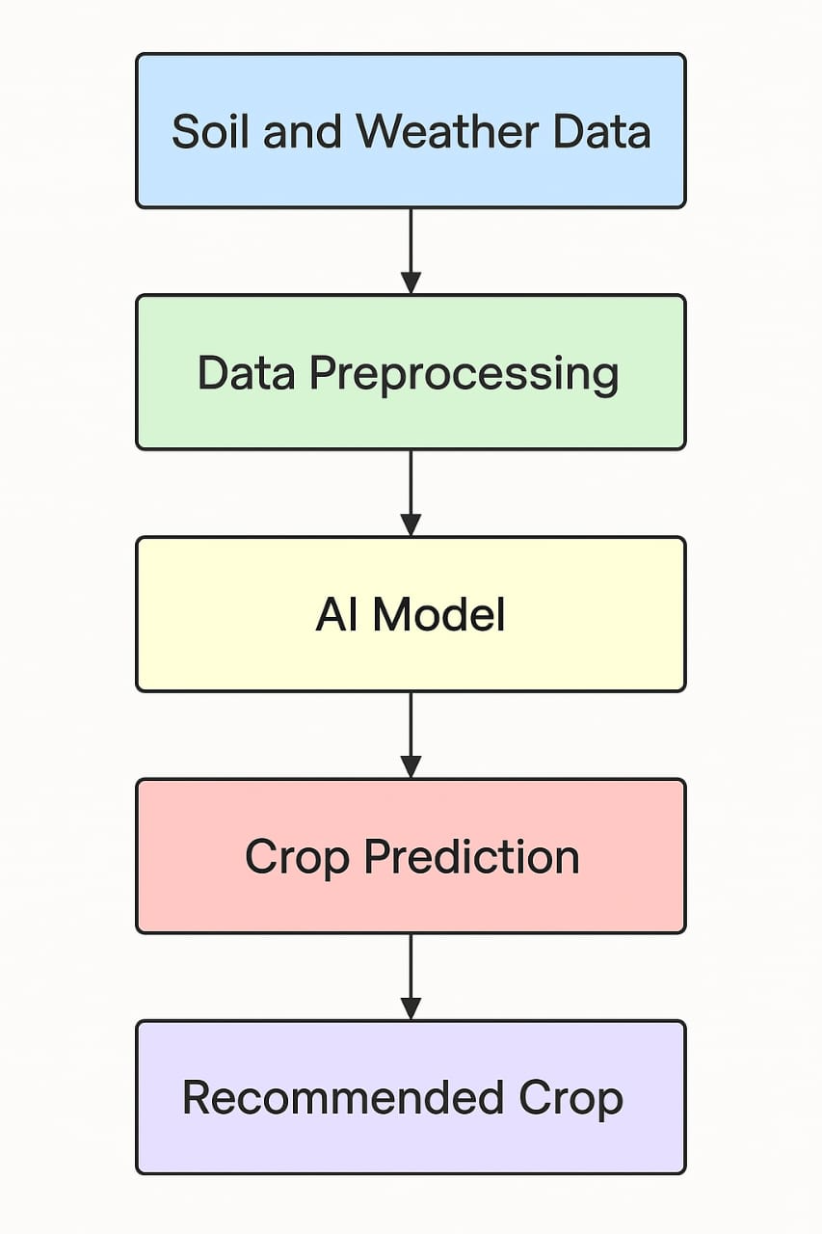
REVOLUTIONIZING AGRICULTURE : PREDICTING CROPS WITH AI AND WEATHER DATA
BLOCK DIAGRAM :

Slide 12
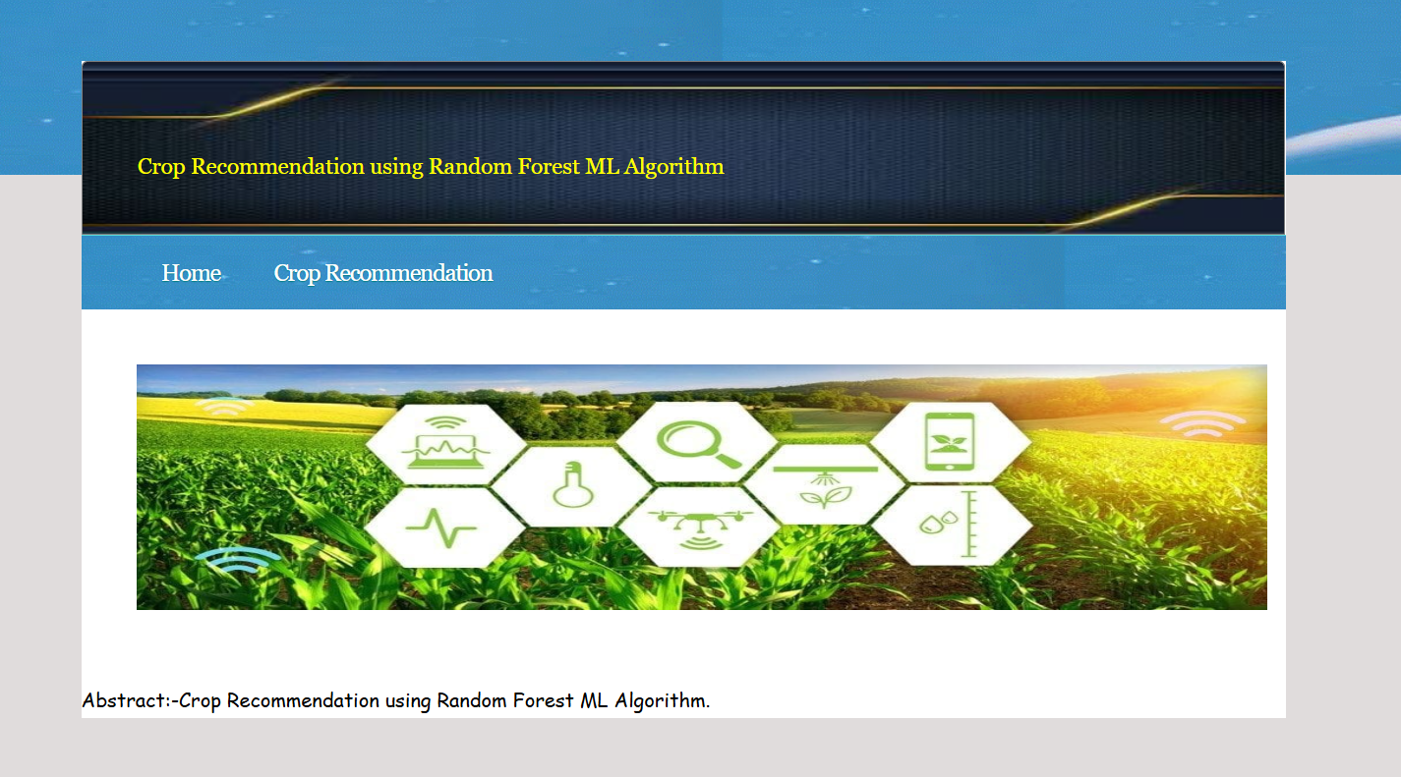
REVOLUTIONIZING AGRICULTURE : PREDICTING CROPS WITH AI AND WEATHER DATA

Slide 13
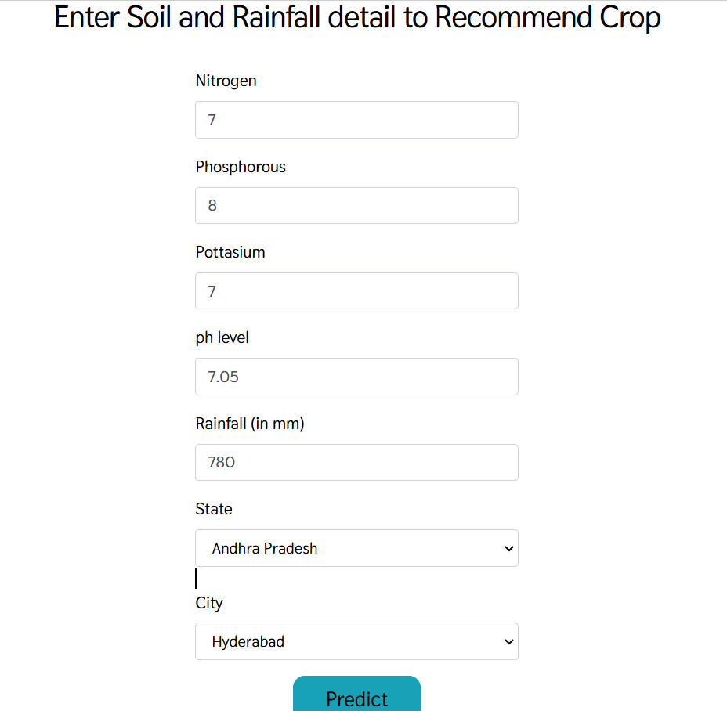
REVOLUTIONIZING AGRICULTURE : PREDICTING CROPS WITH AI AND WEATHER DATA

Slide 14
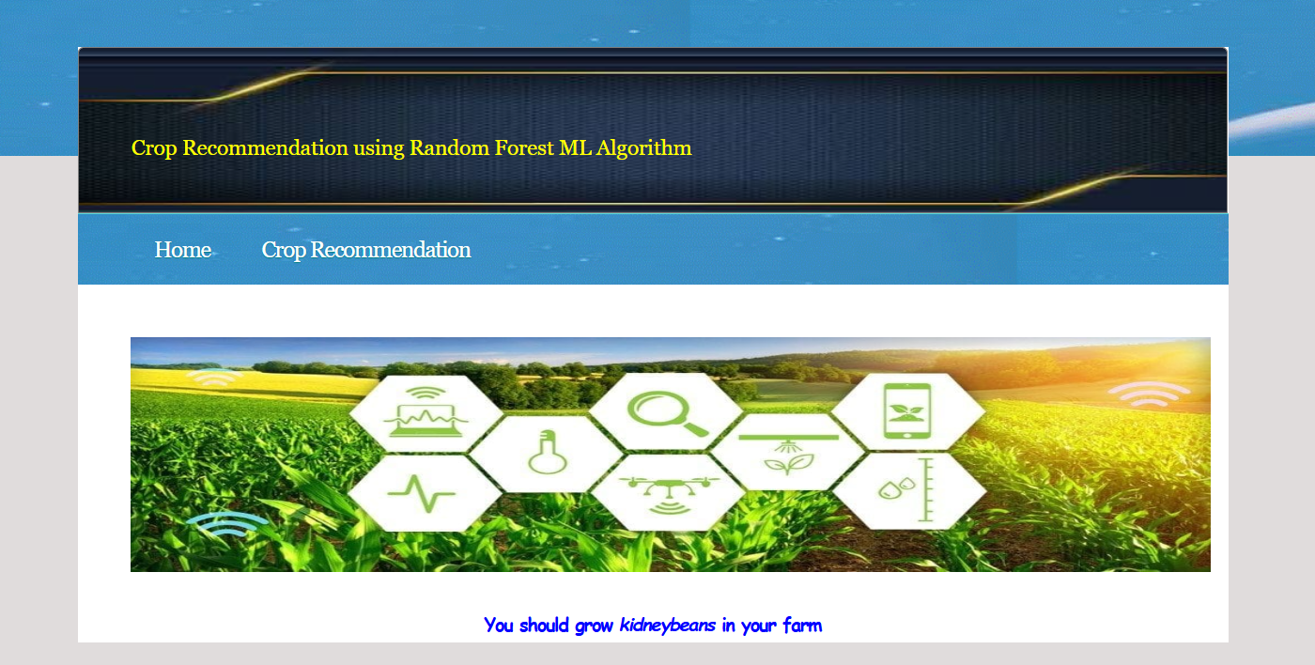
REVOLUTIONIZING AGRICULTURE : PREDICTING CROPS WITH AI AND WEATHER DATA

Slide 15
REVOLUTIONIZING AGRICULTURE : PREDICTING CROPS WITH AI AND WEATHER DATA
CONCLUSION AND FUTURE SCOPE
The crop recommendation system enhances agricultural productivity by providing data-driven crop suggestions based on soil and climate conditions, helping farmers make informed decisions while optimizing resource use and reducing crop failure risks.
In the future, the system can be improved by integrating IoT sensors for real-time monitoring, utilizing remote sensing data, enhancing prediction accuracy with AI and deep learning, developing a mobile app for accessibility, and adapting recommendations to regional crop patterns and market demand, making it an even more valuable tool for sustainable and efficient farming.

Slide 16
REVOLUTIONIZING AGRICULTURE : PREDICTING CROPS WITH AI AND WEATHER DATA
THANK YOU

